Slide 1
National Hispanic Heritage Month
HISPANICS: ONE ENDLESS VOICE TO ENHANCE OUR TRADITIONS
September 15 – October 15

Slide 2
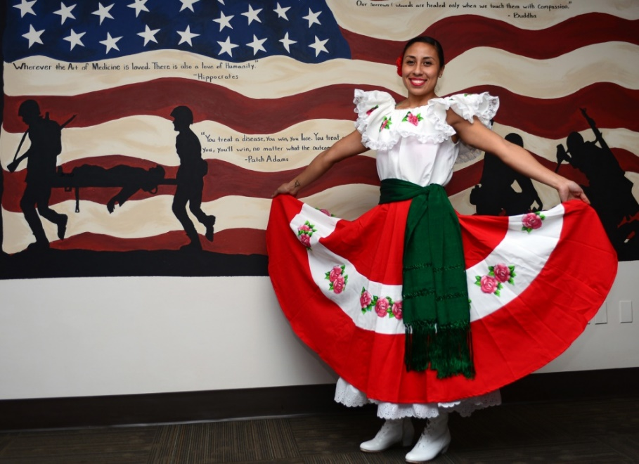
Hispanic Heritage Month
During National Hispanic Heritage Month, celebrated from September 15 - October 15, the Department of Defense (DoD) recognizes Hispanic Americans’ contributions to the United States and celebrates their culture and heritage.
Photo courtesy the U.S. Air Force

Slide 3
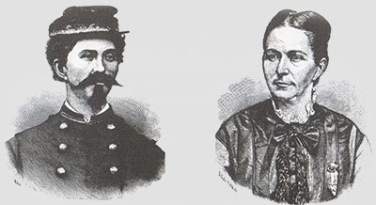
Hispanic Military Service
Hispanic Americans have an undeniable and proud record of military service, dating back to the Civil War. Whether their origins can be traced to Spain, Cuba, Puerto Rico, Mexico, or one of dozens of other Spanish-speaking countries or cultures, they have defended America with unwavering valor and honor.
The illustration depicts Loreta Janeta Velazquez and her alias, Lt. Harry T. Buford of the Confederate States Army.
Courtesy of the Library of Congress.

Slide 4
Theme/Presentation Highlights
This year’s theme is: “Hispanics: One Endless Voice to Enhance our Traditions.”
This presentation highlights: Ensign Joseph Tezano, Captain Humbert “Rocky” Versace, Ms. Mary Alamar Young, and Major General Marc Sasseville.

Slide 5
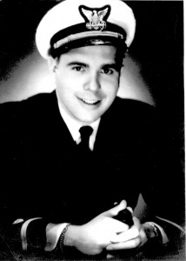
Ensign Joseph Tezanos
In the spring of 1942, 22-year-old Joseph Tezanos, a factory worker and Spanish immigrant, enlisted in the U.S. Coast Guard.
By the end of the decade, he would be a highly decorated war hero, a survivor of one of World War II’s worst accidental maritime disasters (the West Loch Disaster) and one of the first Hispanic American officers in the U.S. Coast Guard.
Photo courtesy U.S. Coast Guard
Joseph Tezanos

Slide 6
Joseph Tezanos
On May 21, 1944, Petty Officer Second Class Tezanos was standing duty on a Landing Ship Tank in Pearl Harbor, Hawaii. Another ship loading ammunition exploded setting off a chain reaction of fires and subsequent explosions.
Tezanos and three of his shipmates made two trips into the affected area, saving approximately 42 injured men. On the third attempt, their small boat was swamped and sank. Tezanos suffered multiple burns. The West Loch Disaster claimed the lives of approximately 163 people and wounded at least 396.
His legacy continues to inspire others in the face of danger. In 2016, the Coast Guard commissioned into service the latest Fast Response Cutter, the U.S. Coast Guard Cutter Joseph Tezanos, to honor him.
Coast Guard Cutter Joseph Tezanos

Slide 7
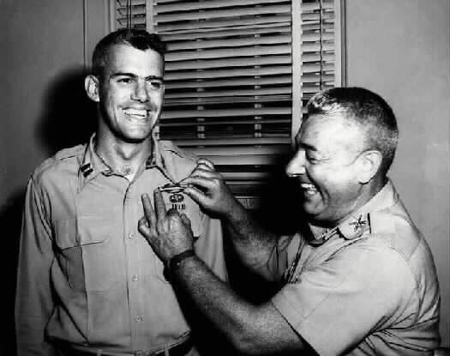
Captain Humbert “Rocky” Versace
Captain Humbert “Rocky” Versace received his commission at the U.S. Military Academy at West Point in 1959.
After graduating from Ranger and Airborne schools, he served in Korea with the 1st Cavalry Division. He then volunteered to go to Vietnam as an advisor. In 1963, Versace’s unit came under intense mortar, automatic weapons and small arms fire during a mission to destroy a Viet Cong command post. Severely wounded, he continued to fight until his capture.
Captain Rocky Versace receives his combat infantry badge from his father, Colonel Humbert Joseph Versace.
Photo courtesy of Arlington Cemetery
Captain Rocky Versace

Slide 8
Rocky Versace
Versace withstood exhaustive interrogations, torture and abuse for 23 months. He attempted to escape four times and inspired other prisoners of war (POW). The last time his fellow soldiers heard his voice, he was singing “God Bless America.”
Versace was finally isolated from other POWs in a series of jungle camps, caged, manacled and placed on extremely reduced rations. The North Vietnamese announced his execution September 26, 1965. His body has never been recovered.
Versace was nominated for the Medal of Honor in 1969 when an escaped POW documented his bravery. He was finally awarded the medal in 2002.

Slide 9
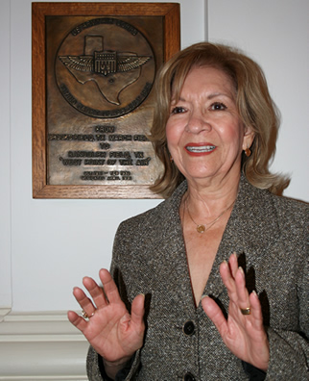
Mary Alamar Young
Mary Alamar Young served 50 years in the Air Force civil service. During her tenure, she championed the employment and advancement of women, minorities and those with disabilities, before retiring in 2011.
Her career began as an administrative assistant where she discovered her passion for helping recruit women and minorities into federal service and promoting equal opportunity.
Photo courtesy
U.S. Air Force
Young’s efforts led to senior personnel recommending her for a new position, Air Force Hispanic Employment Program (HEP) manager. She became the longest-serving Air Force and only female HEP manager since the position was created, serving in that position for ten years.
Mary Young

Slide 10
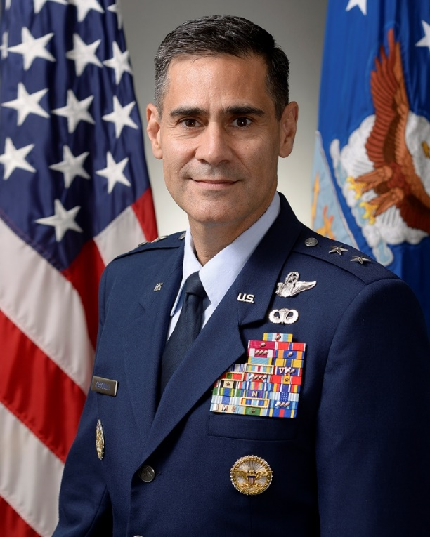
Major General Marc Sasseville
General Marc Sasseville’s career is filled with many accomplishments. Presently, he is the Deputy Director, Air National Guard, the Pentagon, Arlington, Virginia.
On September 11, 2001, he was serving as the 113th Wing vice commander and as an F-16 pilot protecting the nation’s capital when the U.S. was attacked. Lieutenant Colonel Sasseville, and Lieutenant Heather Penney were launched to track hijacked United Airlines Flight 93 and destroy it.
Photo courtesy U.S. Air Force
Major General Marc Sasseville
September 11, 2001

Slide 11
Marc Sasseville
Missiles were absent from the fighter jets, which were only packed with dummy ammunition from a recent training mission, leaving only one way to complete the mission—ramming the aircraft. A suicide military tactic known as a kamikaze mission, named after military aviators from the Empire of Japan during World War II.
Sasseville flew his aircraft alongside the aircraft of his wingman, Lt. Penney. They agreed that he would take out the cockpit and that she would take the tail.
The fighter jets passed over the ravaged Pentagon building; however, it was not until hours later that they would find out that United 93 had already gone down in a field outside Shanksville, Pennsylvania, killing all 44 people aboard including the four hijackers.
September 11, 2001

Slide 12
Conclusion
Today, thousands of Hispanic-American Service members throughout the world are protecting our nation. Just as in generations past, we honor our Hispanic community—military and civilian—for their significant contributions to (or toward) protecting the United States and embodying the DoD values that unite us all as one team.

Slide 13
End
Defense Equal Opportunity Management Institute,
Patrick Air Force Base, Florida
August 2018
All photographs are public domain and are from various sources, as cited.
This presentation is not to be construed as an official DEOMI, U.S. military services, or Department of Defense position.
13

